Slide 1
CARDIAC CATHETERIZATION
IMAGE SEGMENTATION PROJECT

Slide 2
TABLE OF CONTENTS
01
02
03
04
INTRODUCTION
HYPERPARAMETERS
MODELS
FURTHER PLAN
Basic ideas
Experiment routine
Preprocessing
Data argumentation
Learning rate & schedule
Pretrained models
New structures
Discussion
Conclusion
Verification
Other frameworks
Tune hyperparams

Slide 3
INTRODUCTION
01
Basic ideas
Experiment routine

Slide 4
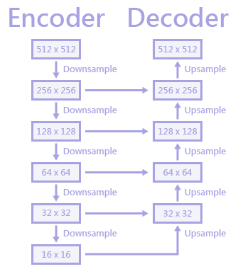
INTRODUCTION
Basic ideas
Use already exist package: segmentation-models-pytorch
Unet – Encoder, Decoder
Experiment routine
Most suitable backbone
Same settings for comparison
Choose the best structure for further research
Add new structure to improve model accuracy

Slide 5
HYPERPARAMETERS
02
Preprocessing
Data argumentation
Learning rate and schedule

Slide 6
HYPERPARAMETERS
AND OTHER SETTINGS
INPUT IMAGE
Gray-scale
ARGUMENTATION
GridDistortion
ElasticTransform
Affine
GaussNoise
Blur
Downscale
Brightness
Contrast
PREPROCESSING
Contrast: CLAHE
Mask: float
Image: float
TRAINING SETTINGS
Epoch = 20
Split seed = 4
Transform seed = 10
Shuffle seed = 6
Model seed = 99
Train
batchsize = 8
transform_p = 0.8
Validation
batchsize = 8
ratio = 0.05
transform_p = 0.8
Validation w/o arg
The same as above
MODEL
Backbone choice
ResNet-50 (23M)
DenseNet-201 (18M)
EfficientNet-b4 (17M)
Initial weights
Pretrained
Non-Pretrained
Attention method
Downsample
Residual block
LOSS FUNCTION
Dice loss * 1
Smooth = 1
BCE loss * 0.2
Input logit = True
OPTIMIZER
Adam
Learning rate = 0.001
SCHEDULE
Reference

Slide 7
MODELS
03
Pretrained models and backbones
New structures
Discussion

Slide 8
MODEL STRUCTURE
BACKBONE
SMP package: Unet – EfficientNet-b4, ResNet50, DenseNet201
New structures
HEAD
Conv2D(in=4,out=2,k=1) + Mish
Conv2D(in=2,out=1,k=1) + None
METHODS
Forward
Predict(threshold=0.5)

Slide 9
BASIC BACKBONES
Similar in memory usage when training and model size
 | EfficientNet-b4 | ResNet50 | DenseNet201
Model size (M) | 17 | 23 | 18
Mean Dice Accuracy (threshold=0.5) on val data w/o arg
Pretrained | 0.05123✓ | 0.05833 | 0.09011
Non Pretrained | 0.06709 | 0.05393 | ***
Further research | ✓

Slide 10
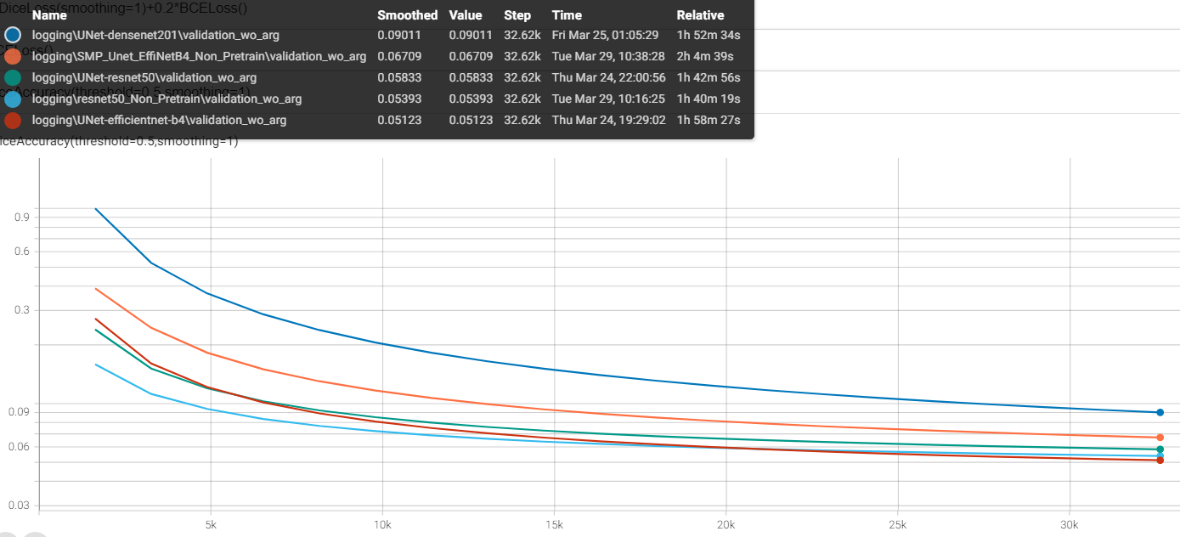
BASIC BACKBONES
Dice accuracy (threshold=0.5) on validation data without argumentation

Slide 11
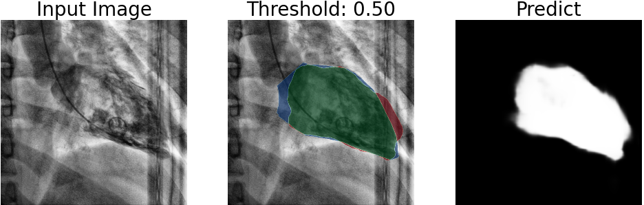
IMAGE PRESENTATION EXAMPLE
Validation dataset without argumentation
Image after preprocessing
Green: True Positive (TP)
Blue: False Negative (FN)
Red: False Positive (FP)
Gray scale image before threshold applied

Slide 12
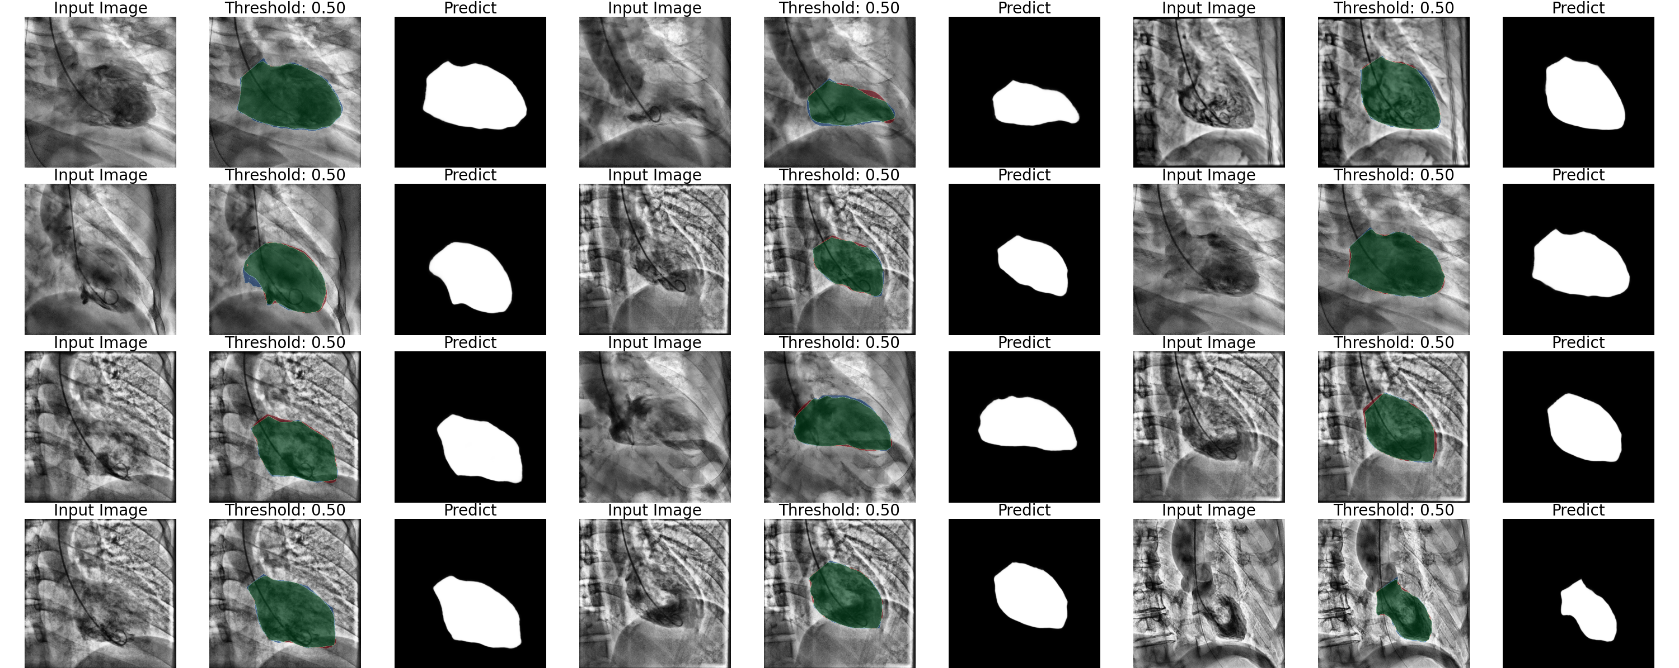
BASIC BACKBONES – EfficientNet-b4 Pretrained

Slide 13
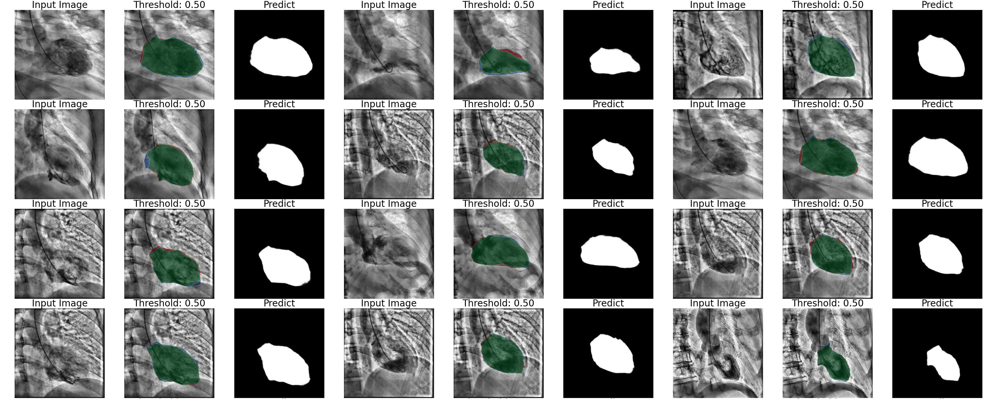
BASIC BACKBONES – EfficientNet-b4 Non-Pretrained

Slide 14
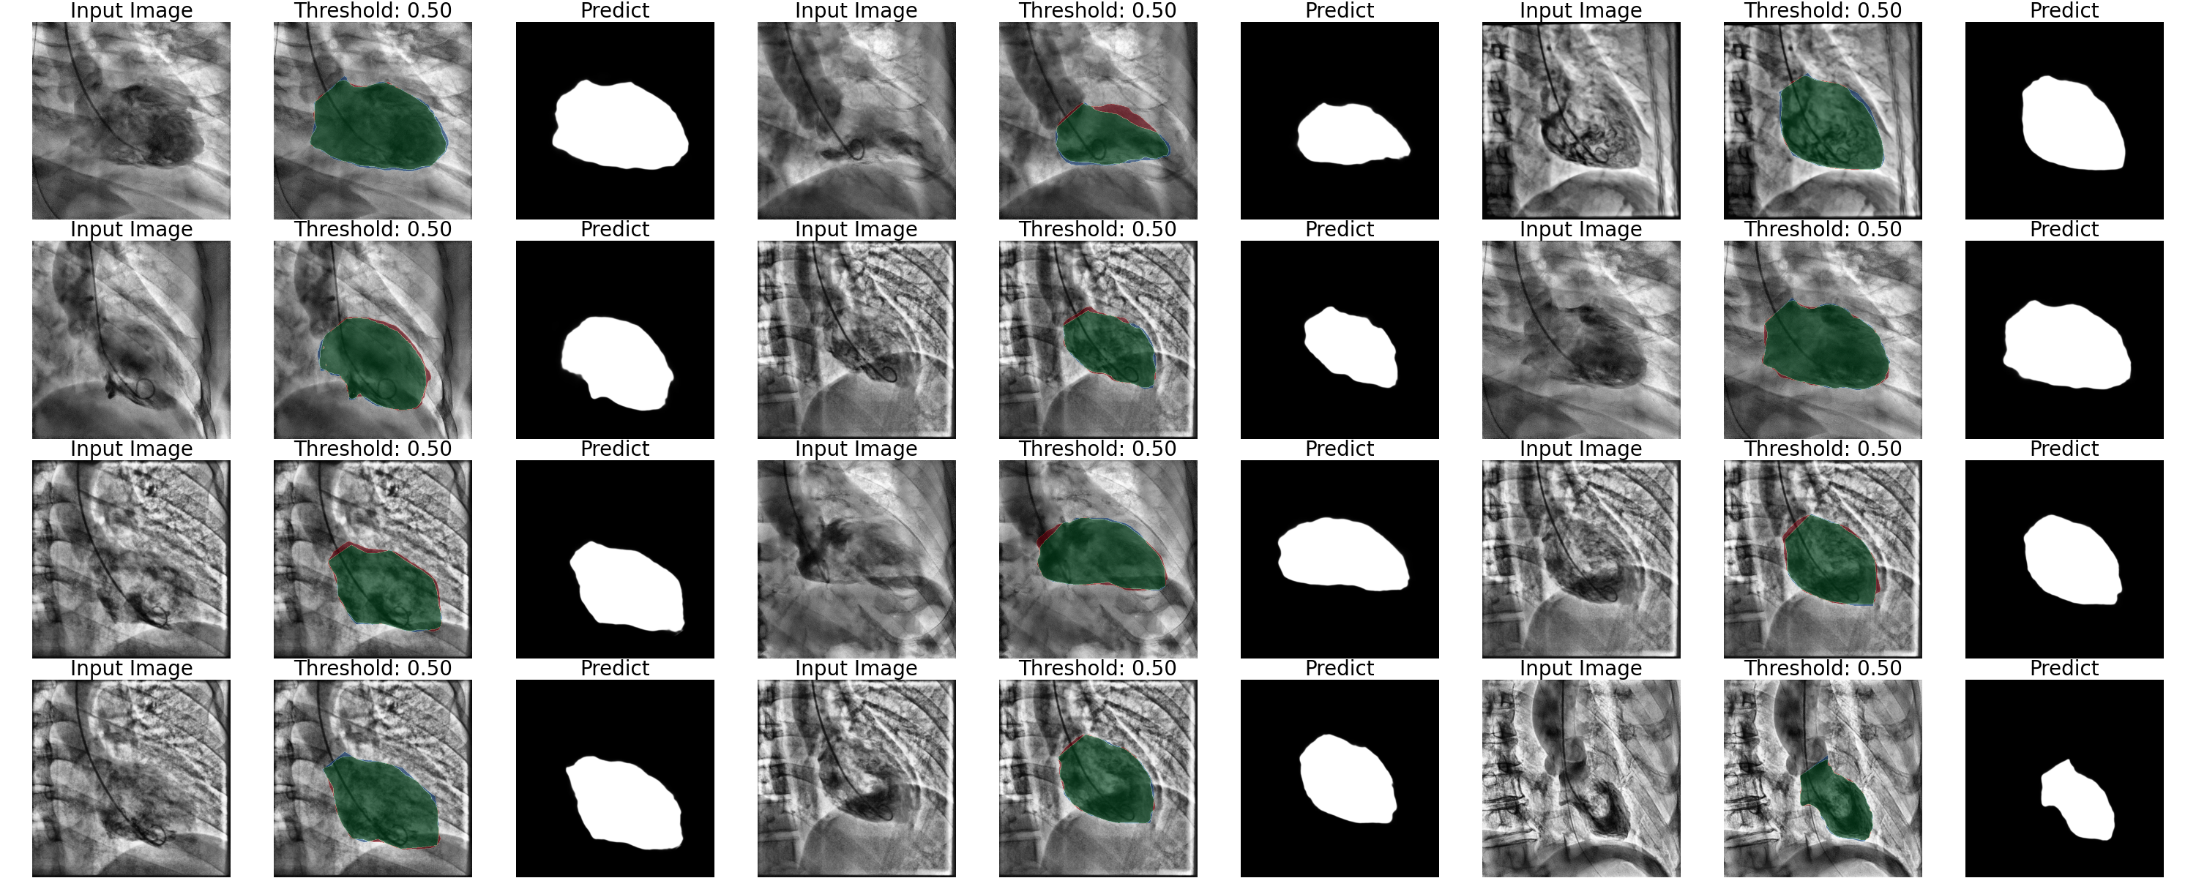
BASIC BACKBONES –ResNet50 Pretrained

Slide 15
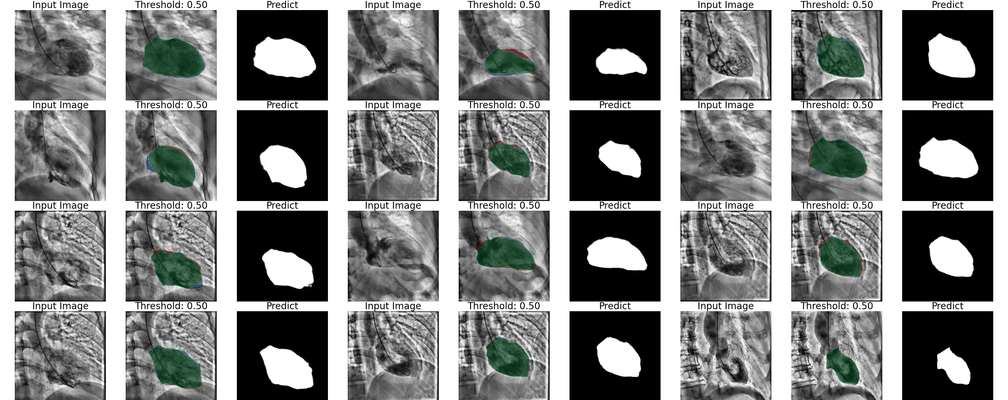
BASIC BACKBONES –ResNet50 Non-Pretrained

Slide 16
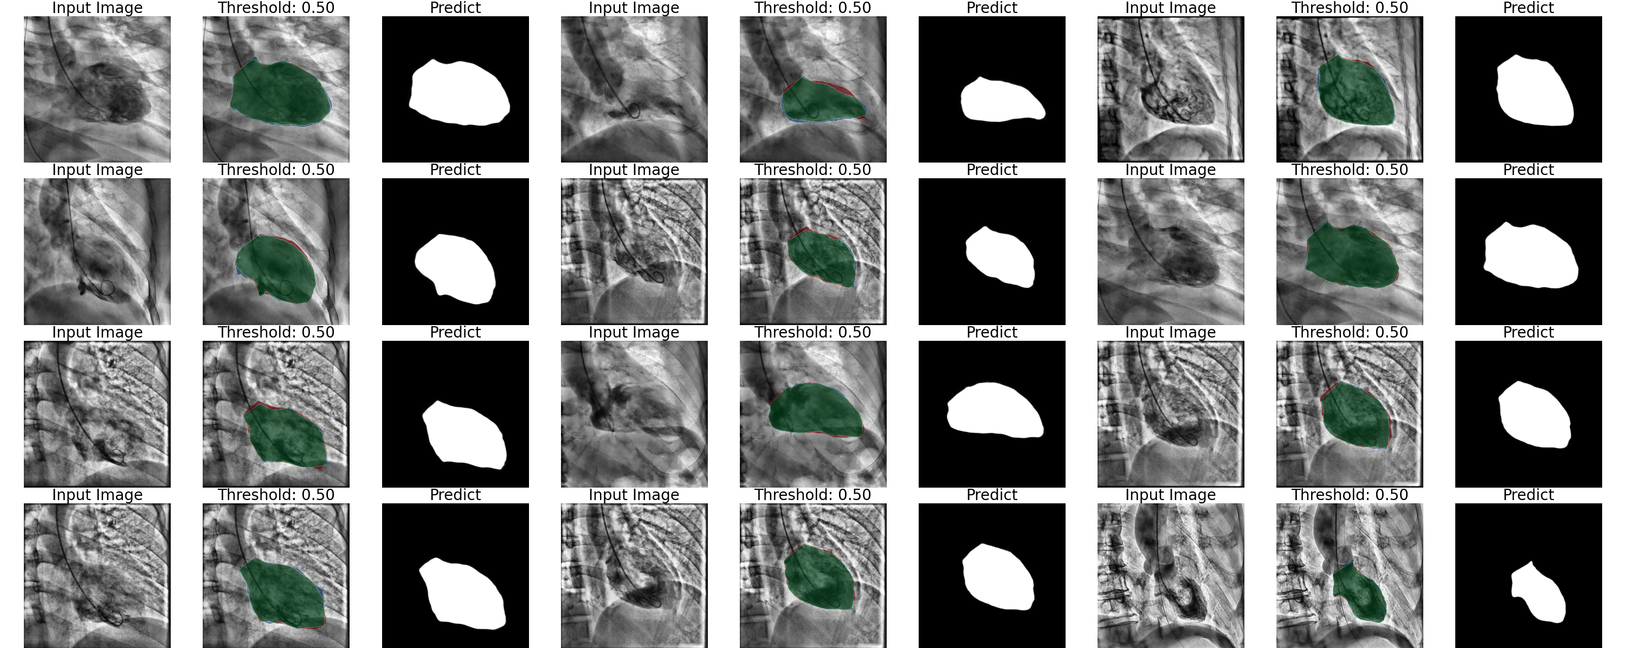
BASIC BACKBONES –DenseNet50 Pretrained

Slide 17

CONCLUSIONS BACKBONE CHOICE
Pretrained weights tends to have more clear edges, but it’s dice accuracy maybe is not the least.
The accuracy between EfficientNet and ResNet are similar, but EfficientNet has less parameters.
Rredict image of DenseNet is slightly worse than others, and has the lowest accuracy.
Select EfficientNet-b4 as backbone for further research.

Slide 18
NEW STRUCTURES Attention technique from the Transformer
RESIDUAL BLOCK
Resblock can be formulated as : x’ = x + f(x), and the coefficients for both x and f(x) are 1, and whether we can use attention technique to find out the proper coefficients and enhance the model accuracy.
DOWNSAMPLE
Downsample step in the model is often executed by the stride in the convolution layer, maybe we can use attention technique to accomplish a more delicate downsample process and extract more meaningful features.

Slide 19
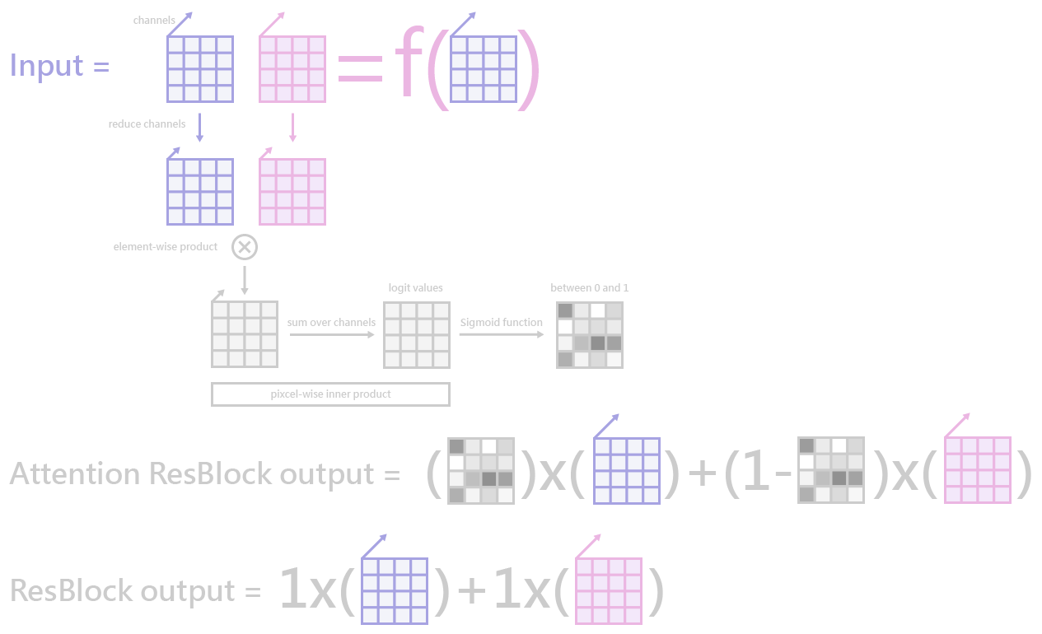
ATTENTION-RESIDUAL STRUCTURE

Slide 20
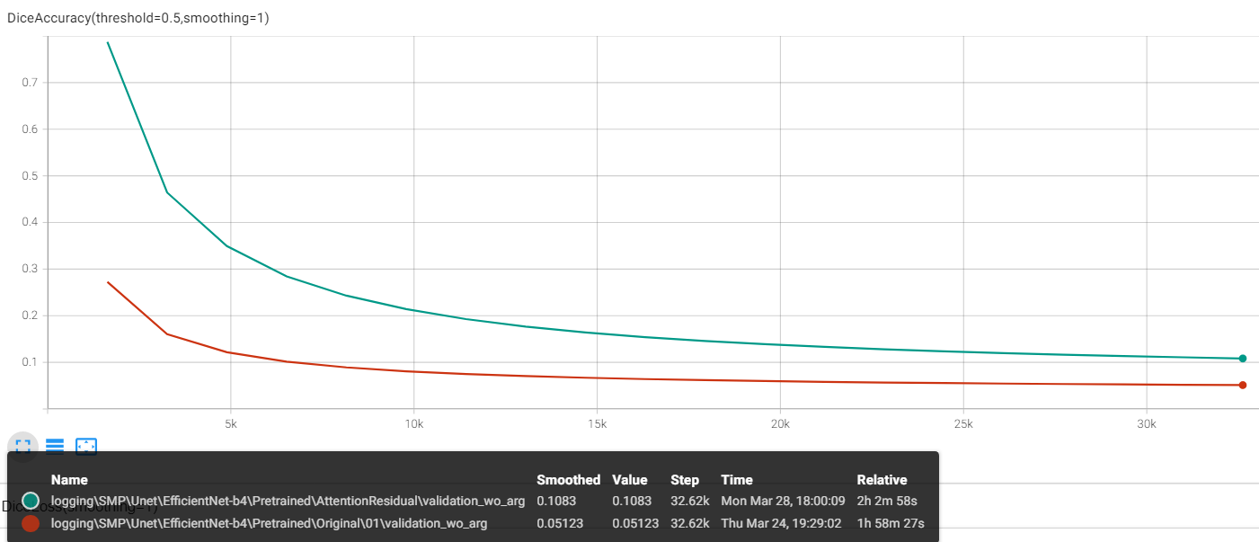
ATTENTION-RESIDUAL RESULT
Attention Residual
Original
Adding the attention technique has negative impact on pretrained EfficientNet.
Maybe it’s because the new structure changes the input value distribution for the next layer.
Maybe rescale like what dropout layer does can help to improve the result.

Slide 21
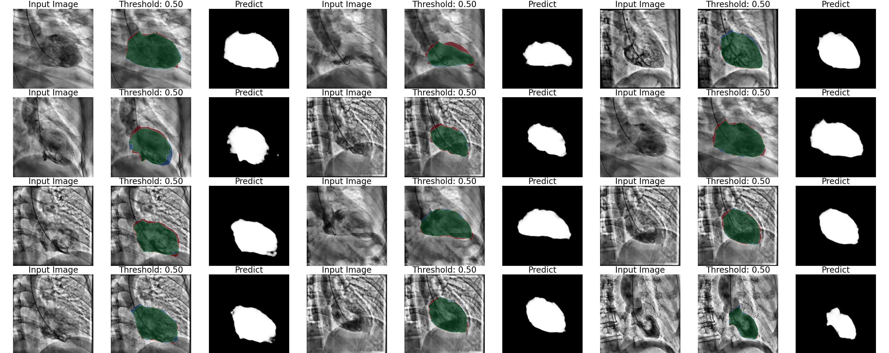
ATTENTION-RESIDUAL RESULT

Slide 22
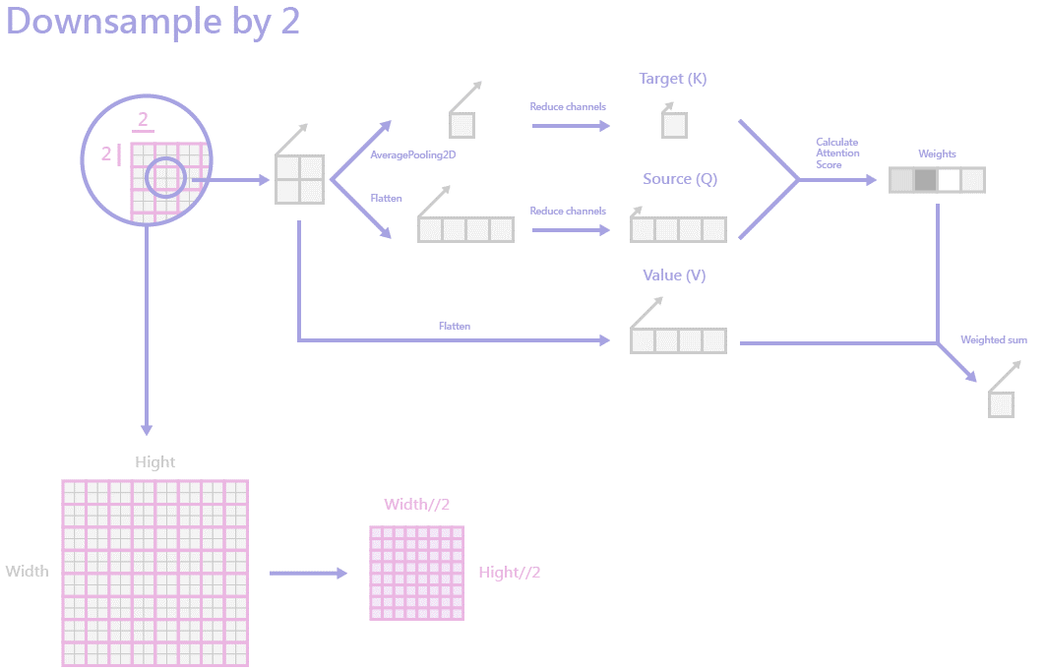
ATTENTION-DOWNSAMPLE STRUCTURE

Slide 23
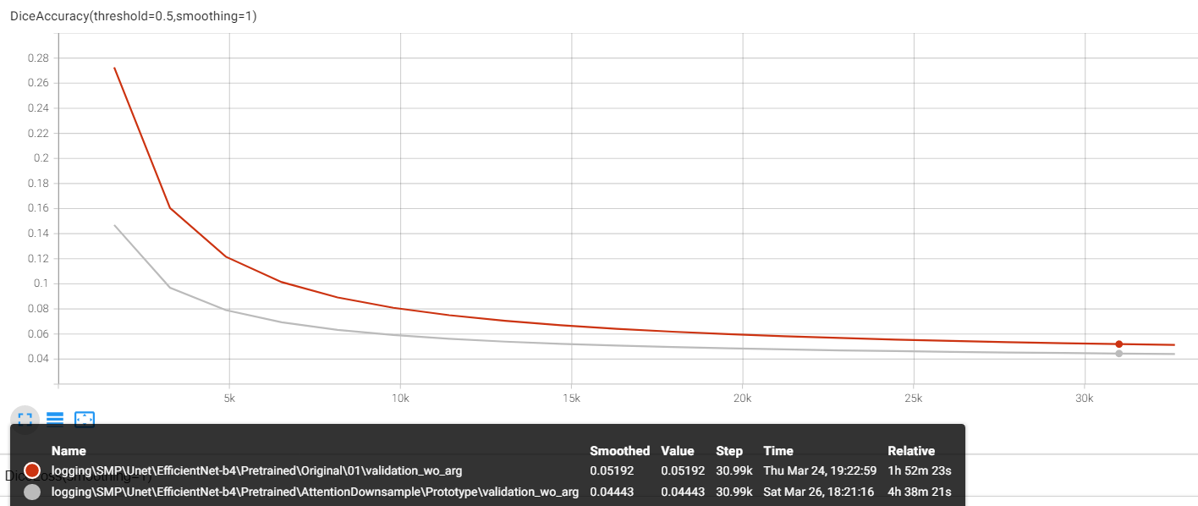
ATTENTION-DOWNSAMPLE RESULT
With attention downsample the result converges to a better place
the process is time consuming.
Original
Attention Downsample

Slide 24
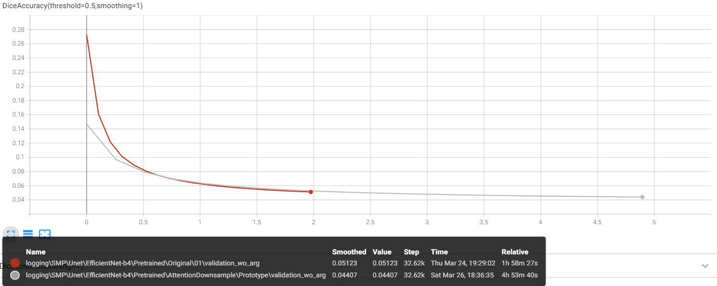
ATTENTION-DOWNSAMPLE RESULT
Maybe it’s because the downsample step is placed after depth-wise convolution layer, and DW Conv relatively slow when the resolution of feature map is high (mentioned in EfficientNet V2 paper)
Try to place the downsample step before DW Conv.
Original
Attention Downsample

Slide 25
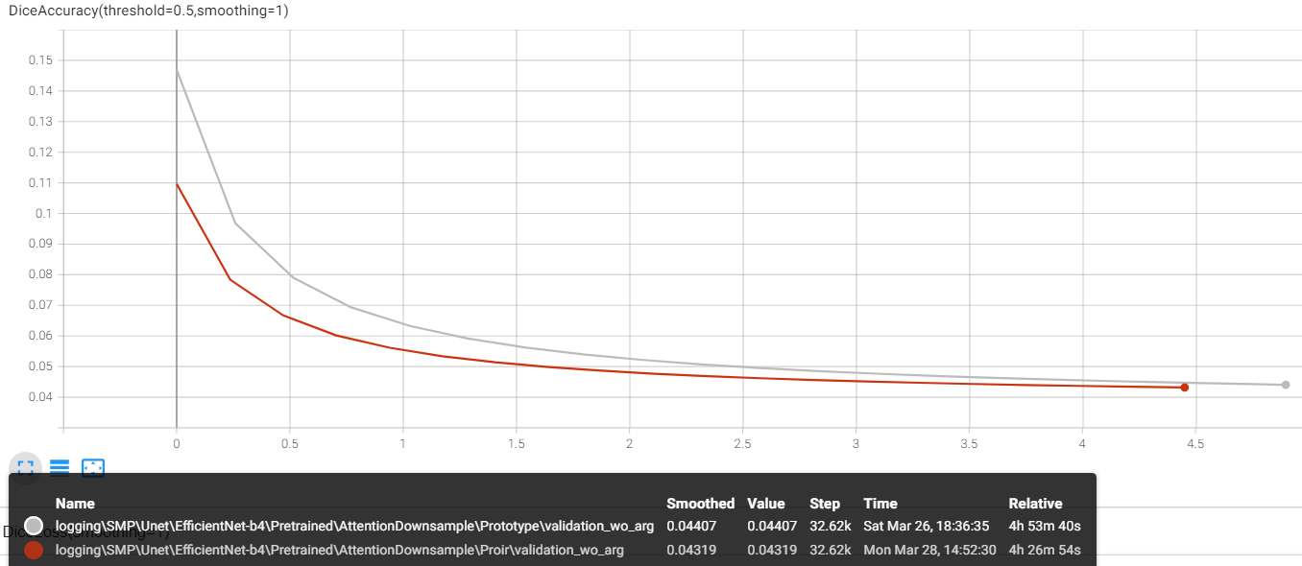
ATTENTION-DOWNSAMPLE RESULT
The training time is slightly imporved, but it still takes too much time.
Downsample before DW Conv is better than after DW Conv with regards to dice accuracy
Downsample after DW Conv
Downsample before DW Conv

Slide 26
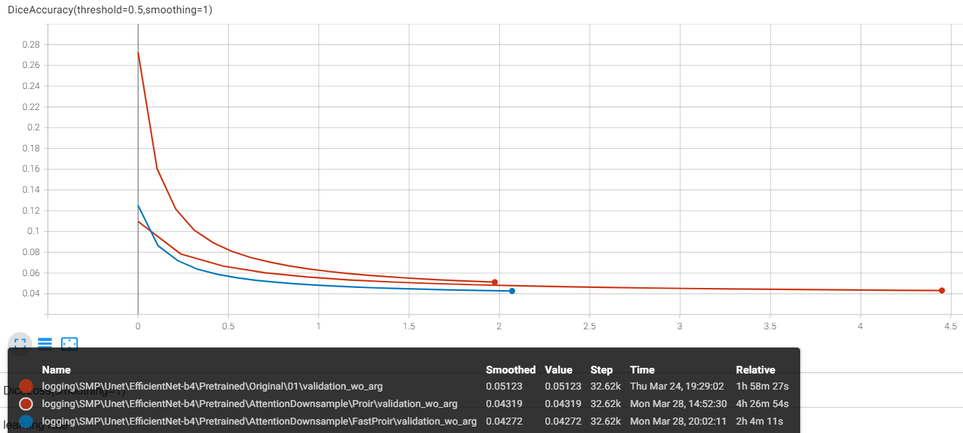
ATTENTION-DOWNSAMPLE RESULT
Simplify the calculating process in downsample layer.
The training time is reduced by 0.5, almost the same as the original model.
Better Convergence than original model.
Original
Downsample before DW Conv
Fast attention downsample

Slide 27
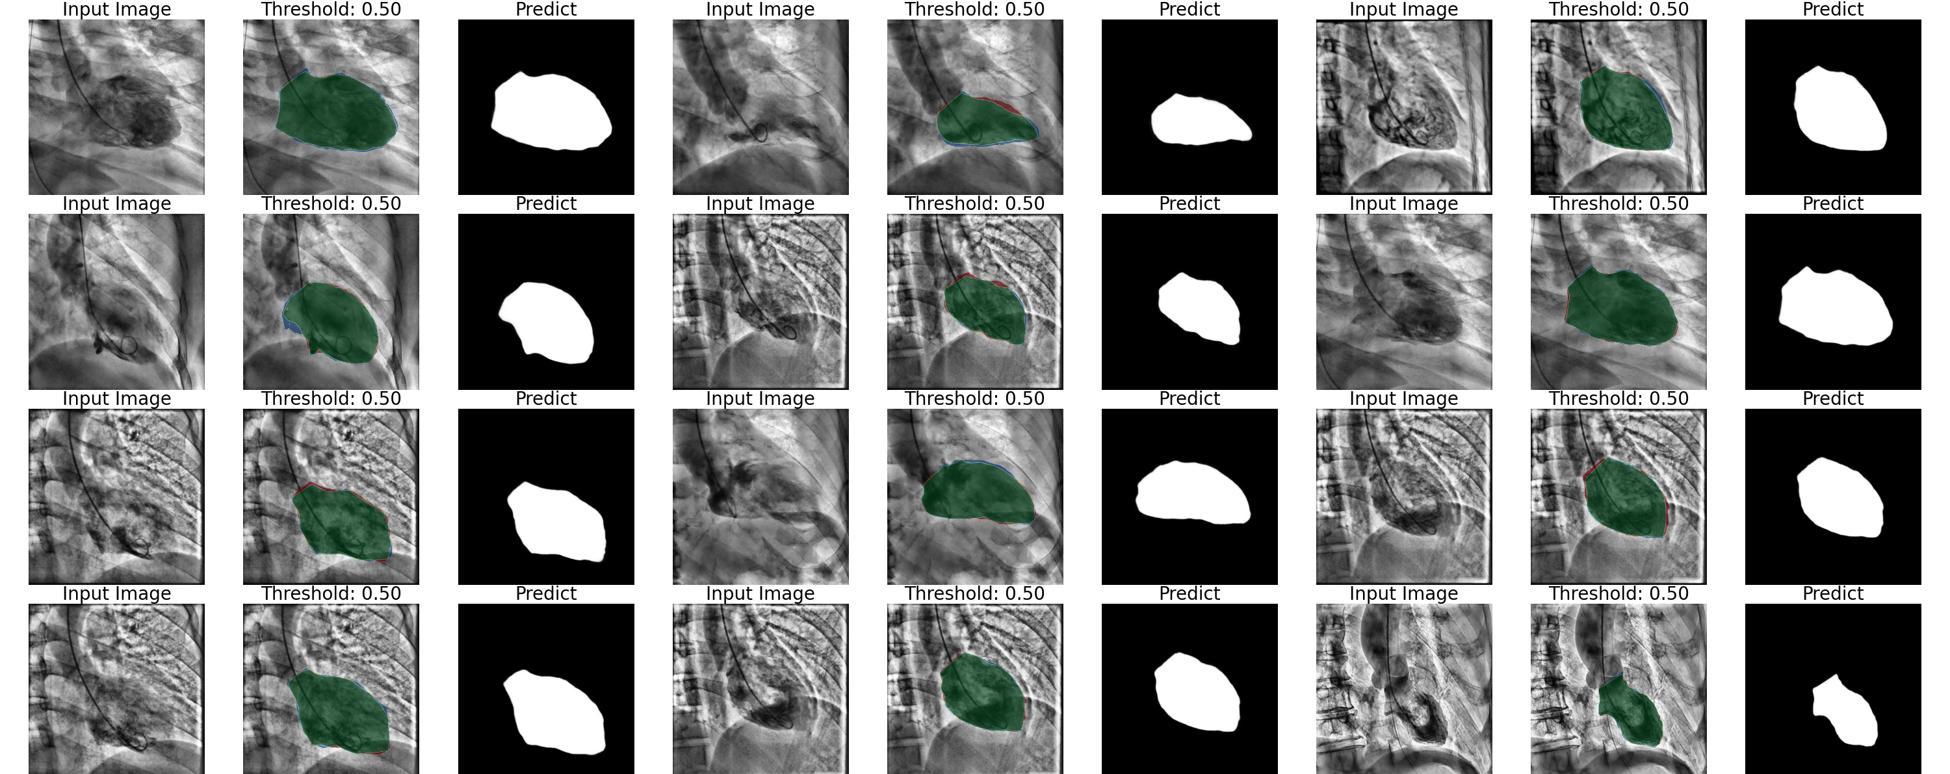
ATTENTION-DOWNSAMPLE RESULT

Slide 28
CONCLUSIONS NEW STRUCTURES
Attention residual is not suitable for adding into pretrained model
Attention downsample improves the accuracy when added before depth-wise convolution layer which stride is 2 and modified to 1.

Slide 29
FURTHER PLAN
04
Verification
Other frameworks
Tune hyperparameters

Slide 30
VERIFICATION
01
02
RANDOM SEEDS
Split seed
Transform seed
Shuffle seed
Model seed (if non-pretrained)
BACKBONE
Use pretrained weights or not
Compare different backbone
Attention downsample
Attention residual

Slide 31
OTHER FRAMEWORKS
DeepLab V3
DeepLab V3+
EfficientNet V2
Unet ++
Fast Fourier Convolution

Slide 32
TUNE HYPERPARAMETERS
OPTIMIZER
DATA ARGUMENTATION
OTHERS
Learning rate
Other optimizers
Sequence
Contents
Schedule
Epochs
Input image channel
Threshold
SCHEDULE
LOSS FUNCTION
ReduceLROnPlateau
CosineAnnealingLR
CyclicLR
BCE loss
Dice loss
Focal loss

Slide 33
THANKS

